Slide 1
The Universe according to NASA… with a little help from some friends
Lynn Cominsky
Press Agent to the Stars
(the real stars, that is)

Slide 2

National Aeronautics and Space Administration

Slide 3
Space

Slide 4

NASA ENTERPRISES
Aerospace
Technology
Biological and
Physical Research
Human Exploration
and
Development of Space
Earth Science
Space Science

Slide 5




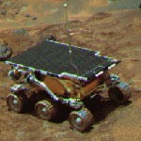

New Millennium Program
Mars Exploration program
Living with a Star

Slide 6


Astronomy and Physics Division
Infrared, Visible and Ultraviolet
Radio, Microwave, X-ray, Gamma-ray, Gravity, Cosmic Rays

Slide 7
Astronomical Search for Origins
Where do we come from?
Are we alone?
Origins is the story of our cosmic roots, told in terms of all that precedes us: the origin and development of galaxies, stars, planets, and the chemical conditions necessary to support life.

Slide 8
Structure and Evolution of the Universe
To explain structure in the Universe and forecast our cosmic destiny;
To explore the cycles of matter and energy in the evolving Universe;
To examine the ultimate limits of gravity and energy in the Universe ranging from the closest stars to the most distant quasars.

Slide 9
Structure and Evolution of the Universe Missions
ACE HETE-2
ASTRO E2 INTEGRAL
Chandra LISA
CHIPS MAP
Constellation-X RXTE
GALEX SWAS
GLAST Swift
Gravity Probe B XMM-Newton
Not yet launched In orbit
Hubble

Slide 10
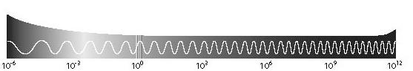
What’s the frequency, Kenneth?
Radio
Infrared
Visible
UV
X-ray
Gamma ray
Energy
(eV)
MAP
ASTRO-E2
Swift
SWAS
Misfits of
Science:
GLAST
GALEX
Chandra
ACE
RXTE
HETE-2
LISA
GP-B
CHIPS
Con-X
INTEGRAL
XMM-Newton

Slide 11

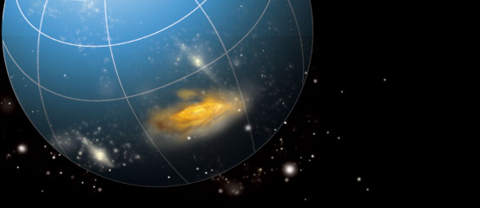
Your first choice for on-line information!
http://universe.sonoma.edu

Slide 12
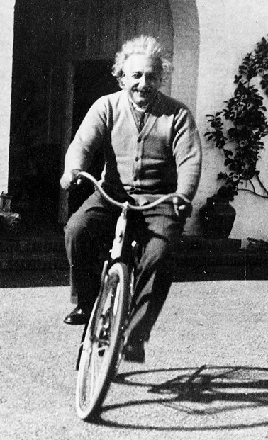
SEU Main research areas
Cosmic Microwave Background
X-ray Astronomy
Gamma-ray Astronomy
Gravity
Coming soon ---- Beyond Einstein!

Slide 13
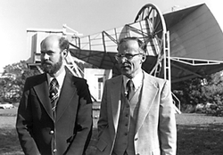
Cosmic Microwave Background
Discovered in 1965 by Arno Penzias and Robert Wilson who were working at Bell Labs
Clinched the hot big bang theory
Excess noise in horned antennae was not due to pigeon dung!

Slide 14
Cosmic Microwave Background
Photons in CMBR come from surface of last scattering – where they stop interacting with matter and travel freely through space
CMBR photons emanate from a cosmic photosphere – like the surface of the Sun – except that we inside it looking out
The cosmic photosphere has a temperature which characterizes the radiation that is emitted
It has cooled since it was formed by more than 1000 to 2.73 degrees K

Slide 15
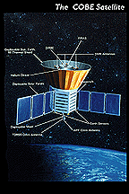
COBE
3 instruments: FIRAS, DMR and DIRBE
Cryogens ran out on 9/ 21/ 90 ending observations by FIRAS and longer wavelengths of DIRBE
DMR and the shorter wavelengths of DIRBE operated until 11/23/93

Slide 16
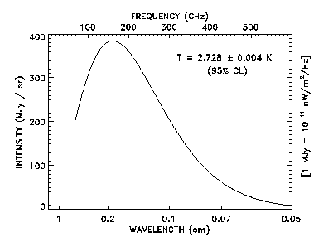
COBE data/FIRAS
Far InfraRed Absolute Spectrophotometer

Slide 17
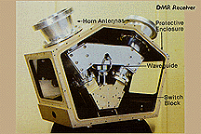
COBE DMR
Differential Microwave Radiometer
3 different wavelengths
2 antennae for each wavelength, 7 degree beam
Pointed 60 degrees apart

Slide 18
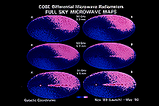
COBE data/DMR
Dipole due to movement of Solar System
warm
cool

Slide 19
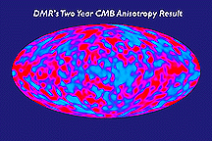
COBE data/DMR
Dipole removed to show “wrinkles”

Slide 20
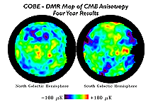
COBE data/DMR
Fluctuations in CMB seen by DMR are at the level of one part in 100,000
Blue spots mean greater density
Red spots mean lesser density
(in the early Universe)

Slide 21
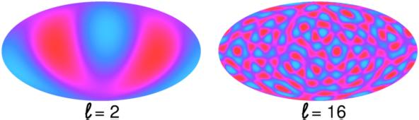
CMBR Fluctuations
COBE measures the angular fluctuations on large scales, down to about L=16
Notes:
sCDM is standard Cold Dark Matter model with critical density. oCDM is an open universe with Cold Dark Matter model Lambda CDM is a model universe with Cold Dark Matter and enough cosmological constant to make space flat STRINGS is a model where large scale structure is seeded by GUT strings.

Slide 22
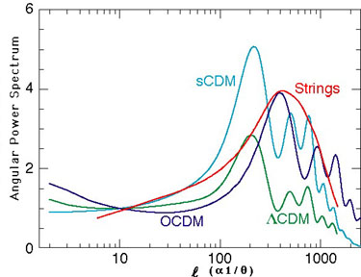
CMBR Fluctuations
Determining the spectrum of fluctuations in the CMBR can directly differentiate between models of the Universe
How much power there is
Angular size of fluctuation
Notes:
sCDM is standard Cold Dark Matter model with critical density. oCDM is an open universe with Cold Dark Matter model Lambda CDM is a model universe with Cold Dark Matter and enough cosmological constant to make space flat STRINGS is a model where large scale structure is seeded by GUT strings.

Slide 23
BOOMERanG
Balloon Observations Of Millimeter Extragalactic Radiation and Geophysics
12 - 20 arc min resolution – about 35 times better than COBE
Two flights: 1998/99 (10 days) and 1999/00
Sensitive to temperature differences as small as 0.0001 degrees C
Imaged 2.5% of entire sky

Slide 24
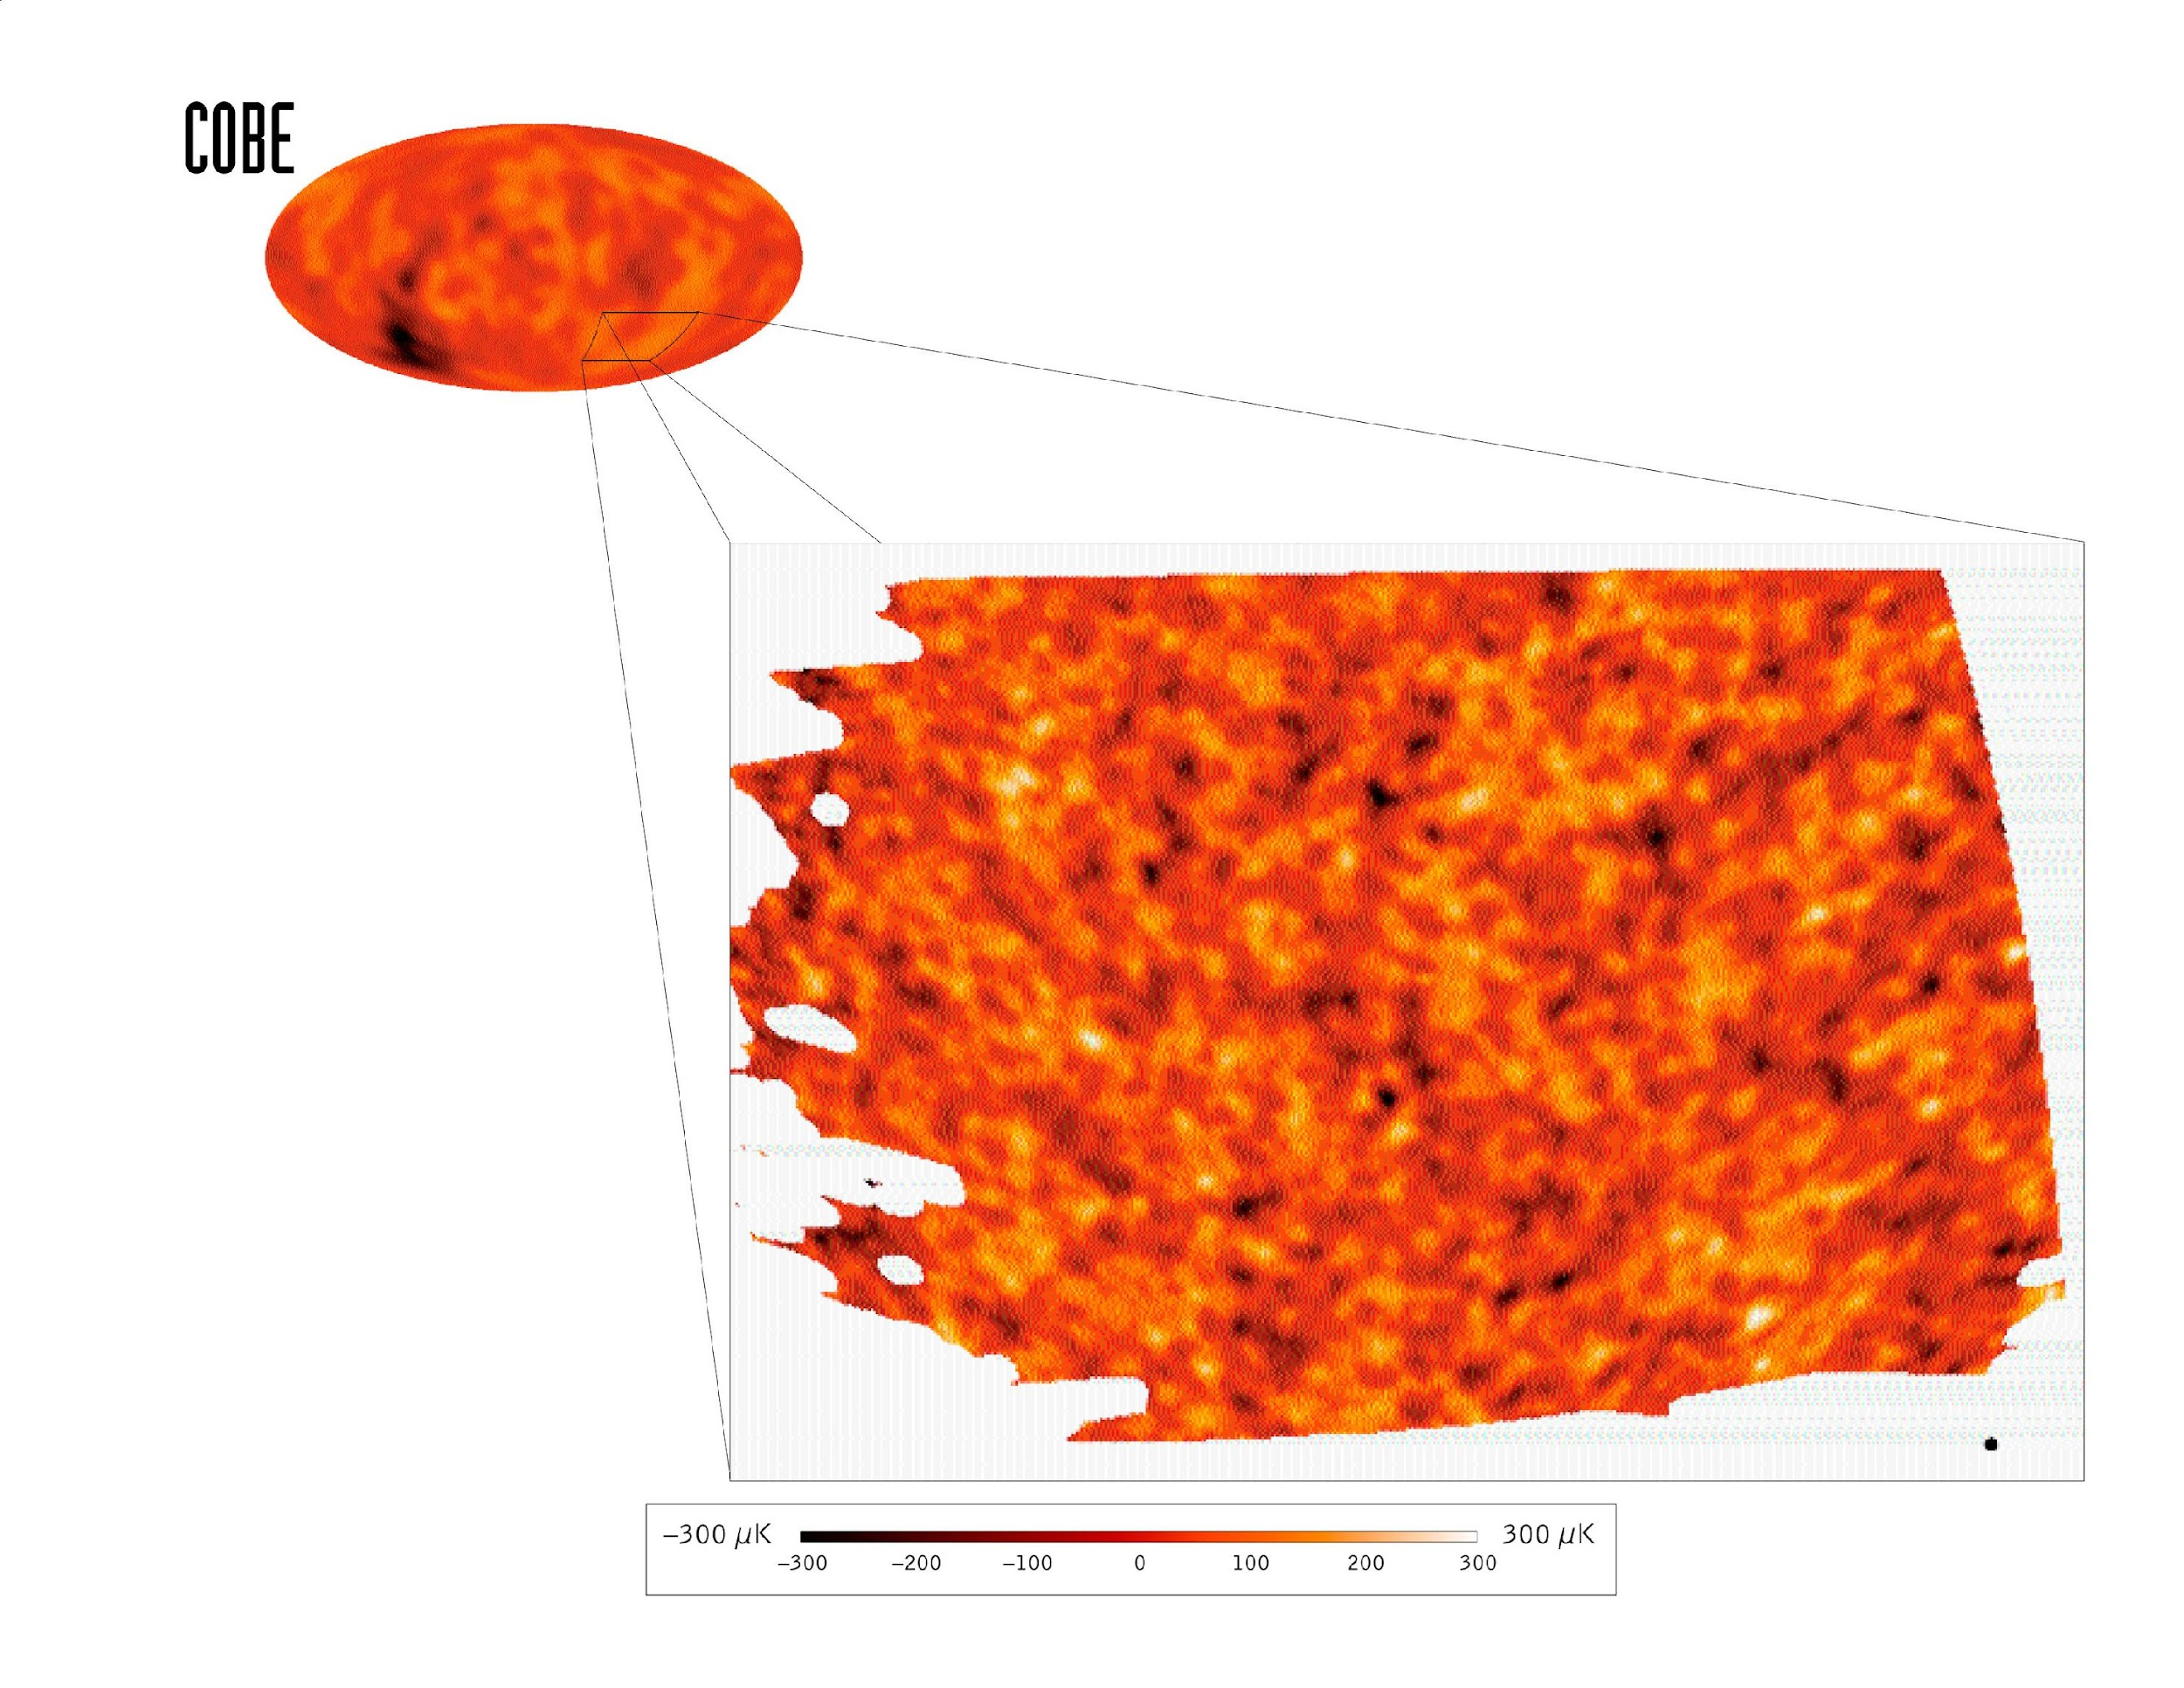
BOOMERanG vs. COBE
1800 square degrees of sky
moon
-300 μK
+300 μK

Slide 25
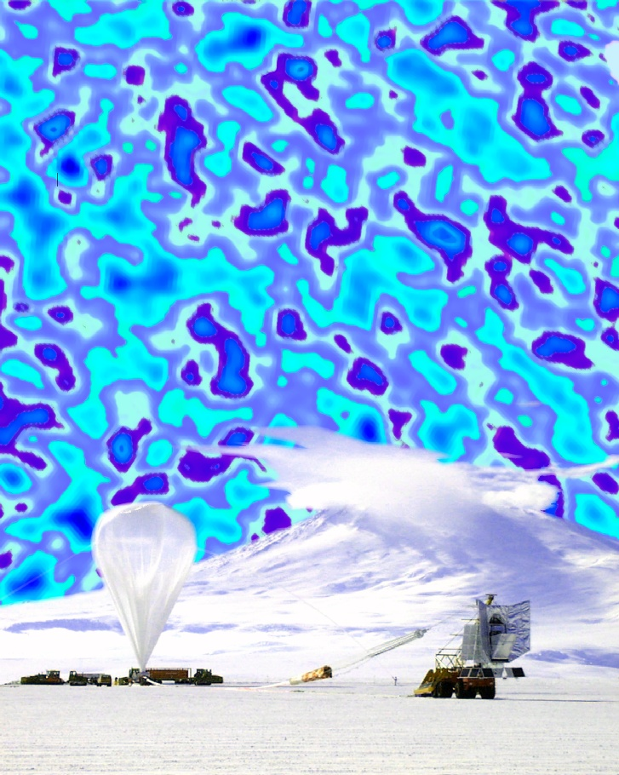
BOOMERanG 1998 Data
What the fluctuations would look like to scale on the real sky above the BOOMERanG balloon launch facilities

Slide 26
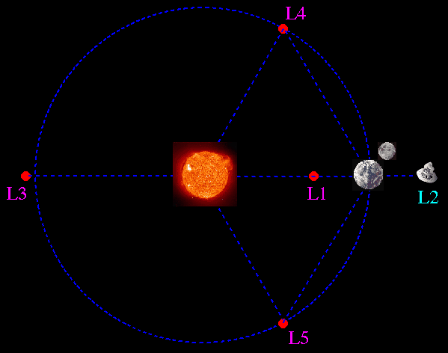
Microwave Anistropy Probe
L2 is one of the 3 semi-stable points in the Earth-Sun binary system
Another body can orbit at this point at a fixed distance from the Earth and the Sun with corrections every 23 days
MAP launched 6/30/01
Reached L2 10/1/01

Slide 27
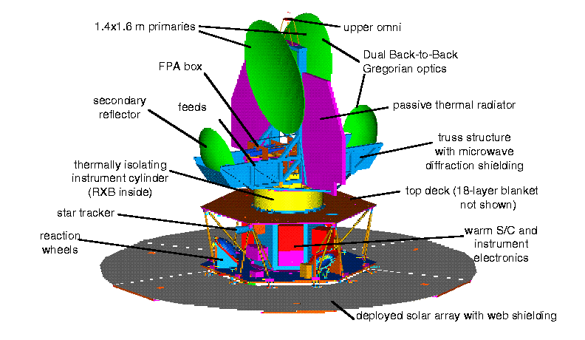
Microwave Anistropy Probe

Slide 28
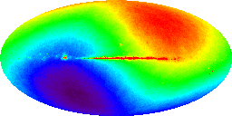
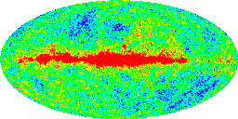
Microwave Anistropy Probe
Dipole as predicted byi MAP simulations
Fluctuations as predicted by MAP simulations

Slide 29
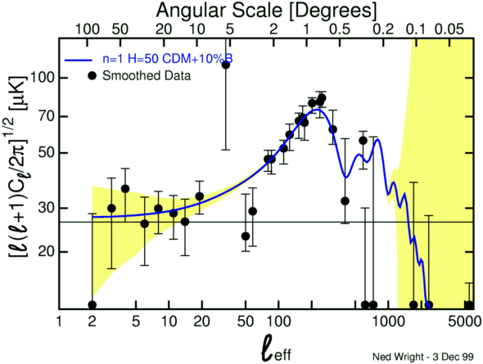
MAP limits
MAP will have error bars as shown in yellow, improving data until about L_{eff} = l000
First MAP data release expected 01/03!!

Slide 30
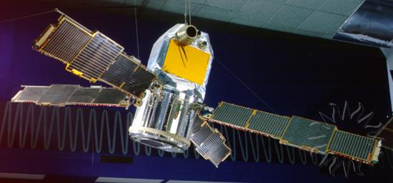
X-ray Astronomy – a brief history
Began in 1962 with the discovery of first extra-solar X-ray source in a rocket flight by Giacconi et al. (Sco X-1)
First satellite was SAS-A aka Uhuru (1970-3)
Uhuru

Slide 31
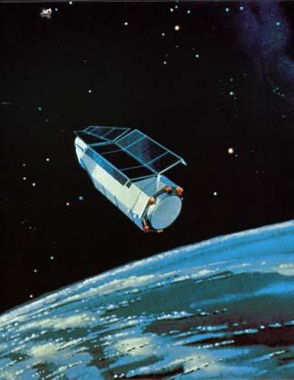
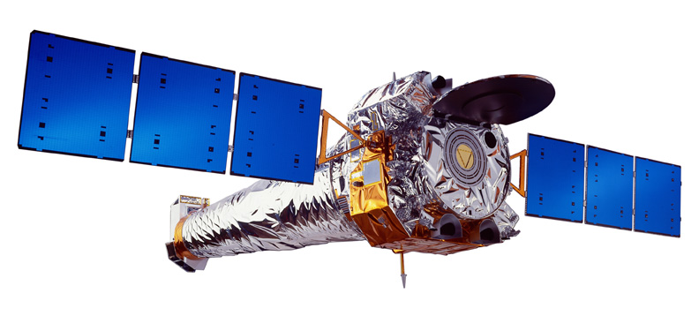
X-ray Astronomy
First imaging X-ray satellite was Einstein Observatory (1978-81)
Currently in orbit: RXTE, Chandra and XMM-Newton (ESA/NASA)
Einstein
Chandra

Slide 32
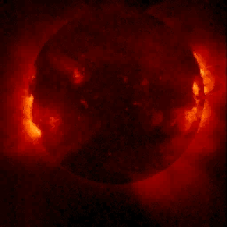
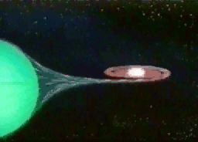
X-ray Sourcery
Earliest source was Sun – corona and flares
Then neutron stars and black holes in accreting binaries were discovered to be strong x-ray emitters – 10 orders of magnitude greater!

Slide 33
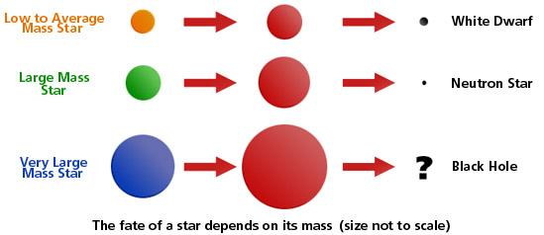
Stellar evolution made simple
Neutron Stars all have ~1.4 solar masses
Black holes have more than 3 solar masses…to billions!

Slide 34
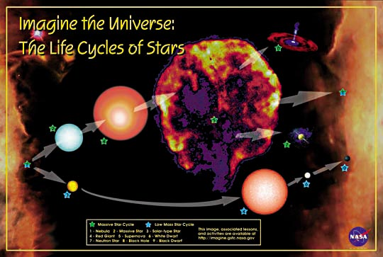
A more complicated view…

Slide 35
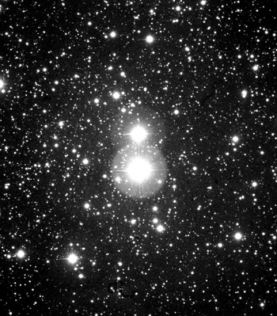
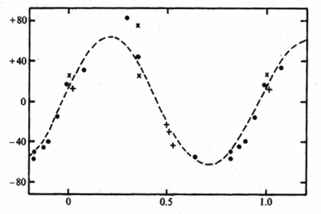
The First Black Hole
Cygnus X-1 binary system
Identified in 1972
Most likely mass of BH is 16 (+/- 5) solar masses
Mass determined by Doppler shift measurements of optical lines

Slide 36
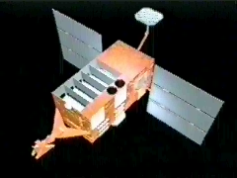
Rossi X-ray Timing Explorer
Launched in 1995 – still operational
Large area X-ray detectors to study timing details of material falling into black holes or onto the surfaces of neutron stars
5 proportional counters with a total collecting area of 6500 square cm
Energy range: 2 - 60 keV
Time resolution: 1 microsec
Spatial resolution: 1 degree

Slide 37

“Old Faithful” Black Hole
movie
Binary black hole system known as “microquasar”
Regular X-ray outbursts discovered with RXTE
Outbursts are linked to appearance of IR jets

Slide 38
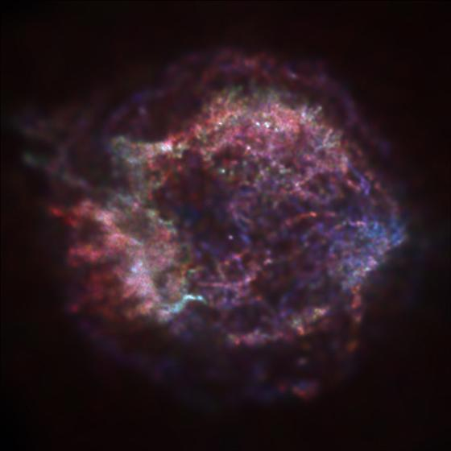
Chandra X-ray Observatory
1 arcsecond images 🡪 “HST of X-ray Astronomy”
Breakthroughs in every area of study
Stars
Compact Objects
Galaxies
Galaxy Clusters
1-10 keV X-rays
Launched 7/23/99
Cas A SNR shows central NS in one of Chandra’s first images

Slide 39
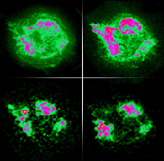
Chandra X-ray Observatory
Total Cas A
Silicon
Calcium
Iron
X-ray spectroscopy shows chemical element distribution

Slide 40

Chandra data
At least 80% of X-ray background is made of discrete sources including two new types:
Very distant galaxies with faint black holes
Bright black holes without visible galaxies
Results were from comparing Chandra data to deep optical surveys from Keck

Slide 41
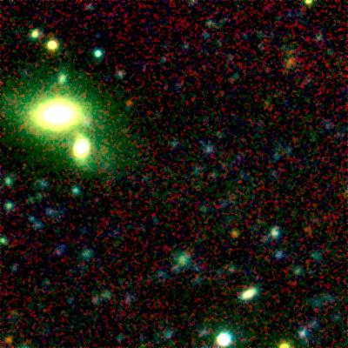
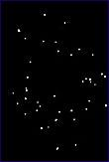
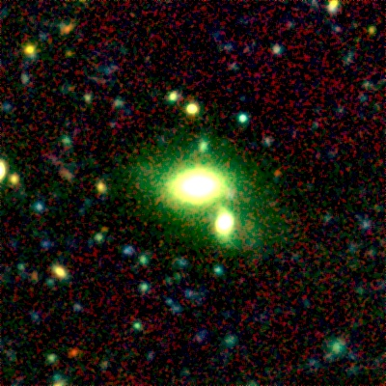
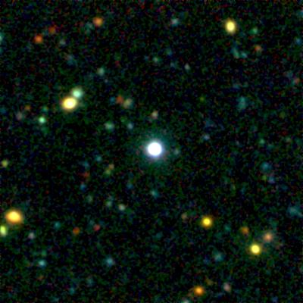
Black Holes Are Everywhere!
Black holes in empty space
Deep Image
Empty
Black holes in“normal” galaxies
Galaxy
Black holes in quasars
Chandra deep field
QSO

Slide 42
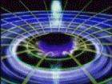
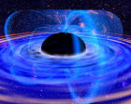
XMM-Newton Mission
Complementary to Chandra - launched 12/10/99
Higher spectral resolution, poorer imaging
XMM-Newton focuses on details of X-ray spectral lines from stars, black holes, galaxies, and galaxy clusters

Slide 43
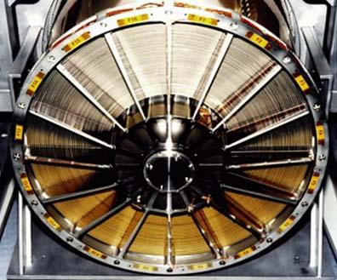
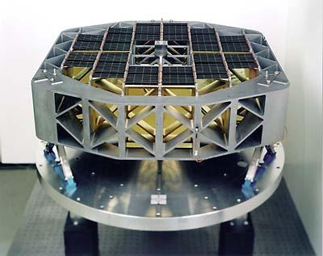
XMM-Newton Mission
Nested grazing incidence optics
Reflection Grating Spectrometer

Slide 44
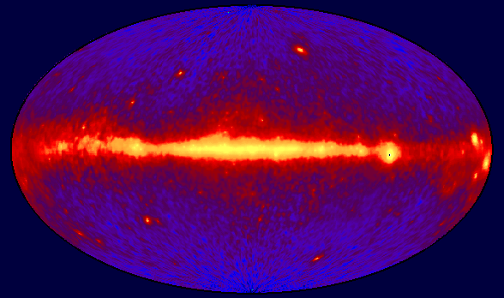
Gamma-ray Astronomy: The Big Picture
Whole sky glows
Extreme environments
Probes of the Universe
CGRO/EGRET All Sky Map

Slide 45
Early Gamma-ray Astronomy
• Gamma-ray Bursts
Vela Program : A Bomb or Not a Bomb?
A few hundred events, a few hundred theories
Gamma-ray Sources
SAS-2 – discovered 2 pulsars (1972)
COS-B – about 25 sources (1975-82)
Most unidentified, but 1 quasar
Diffuse extra-galactic background

Slide 46
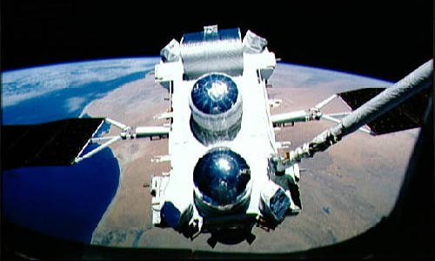
CGRO (1991-2000)

Slide 47
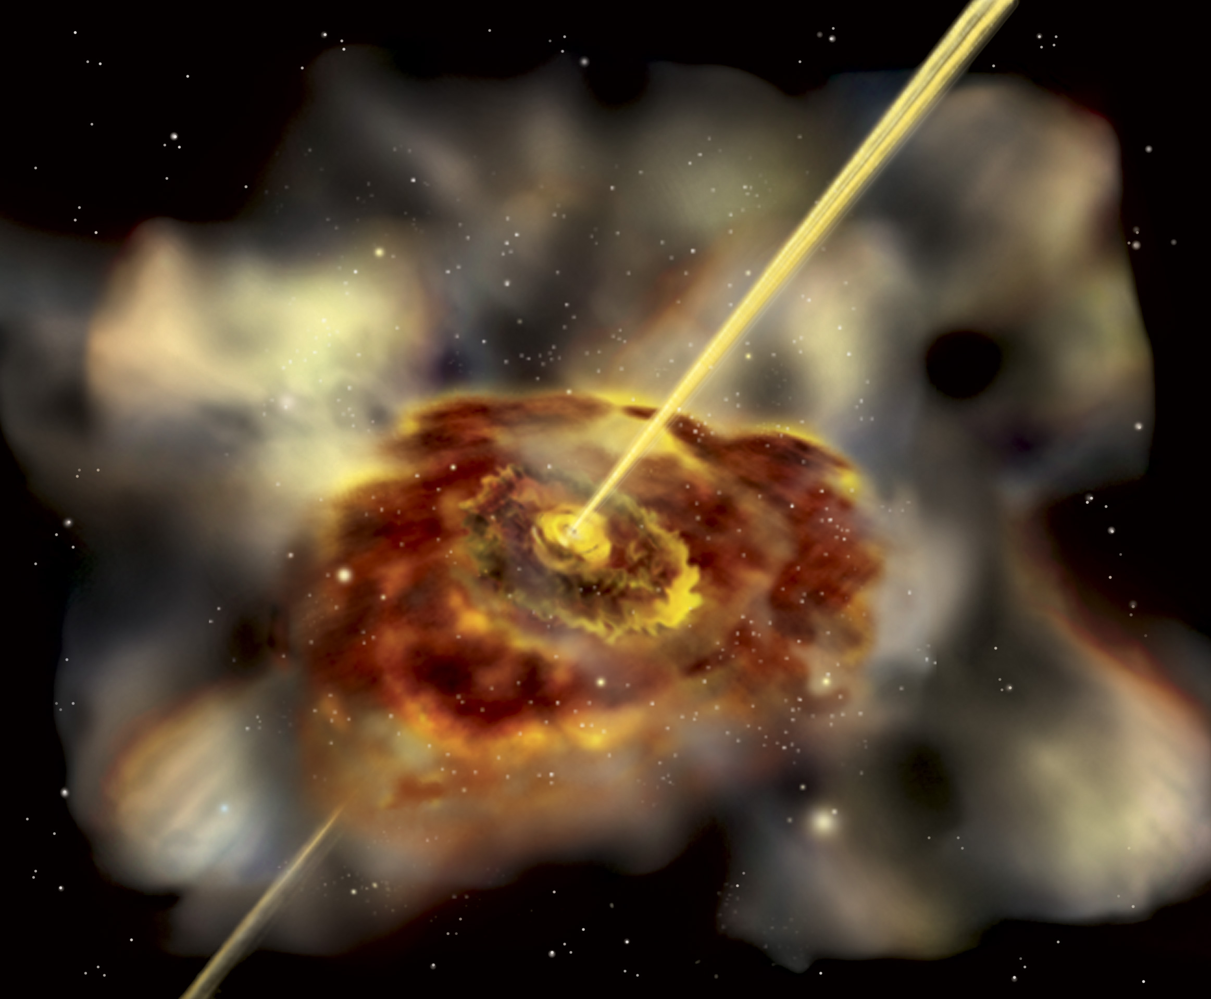
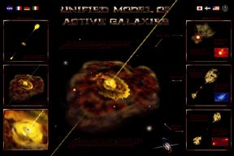
Sources of γ-ray Emission
• Black holes
• Active Galaxies
• Pulsars
• Diffuse emission
• Supernovae
Gamma-ray bursts
• Unidentified

Slide 48
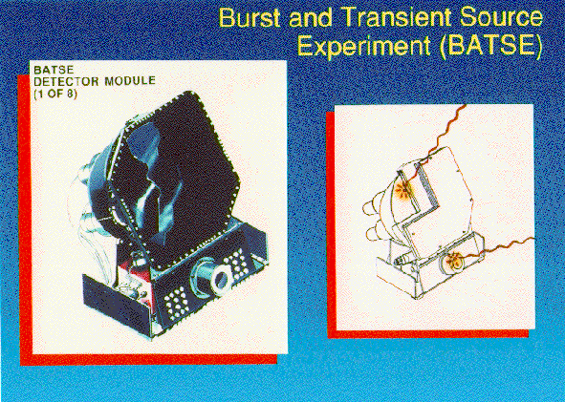
BATSE
Notes:
Each detector module contains two NaI(Tl) scintillation detectors: a Large Area Detector (LAD) optimized for sensitivity and directional response, and a Spectroscopy Detector (SD) optimized for energy coverage and energy resolution.

Slide 49
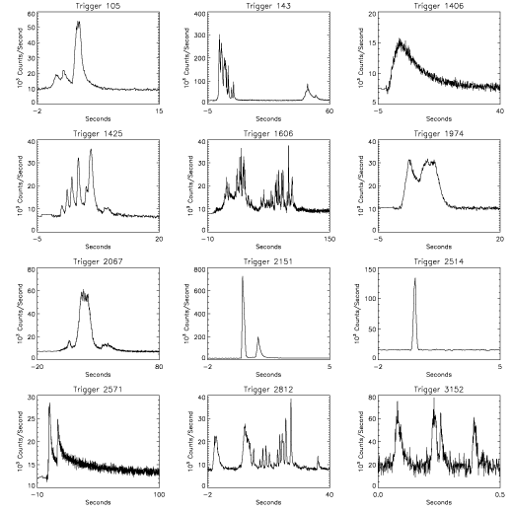
Gamma-Ray Bursts

Slide 50
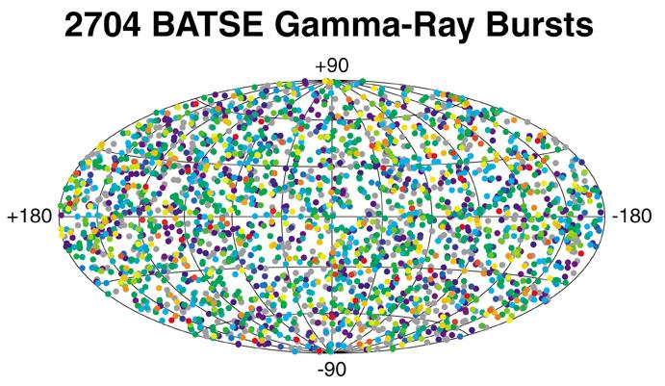

Distribution of GRBs in the Sky

Slide 51
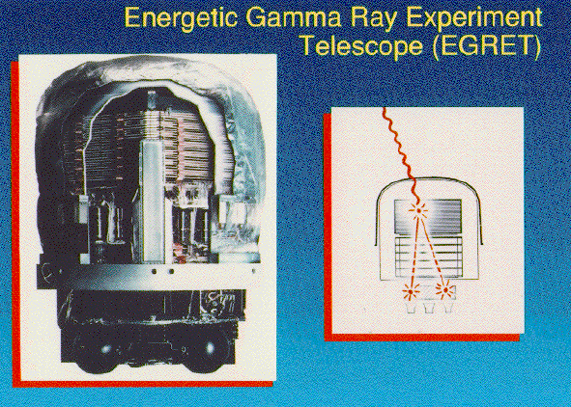
EGRET

Slide 52
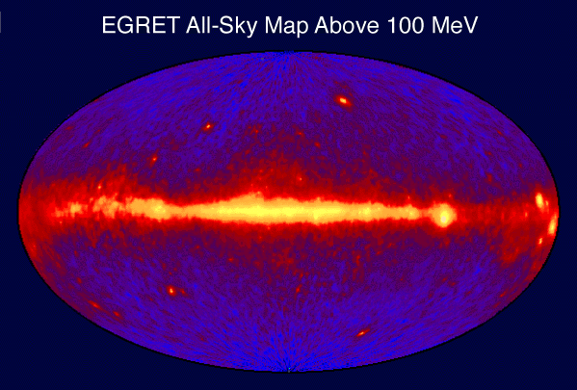
CGRO/EGRET data
30-40% of gamma-ray background is unresolved and extragalactic in origin

Slide 53
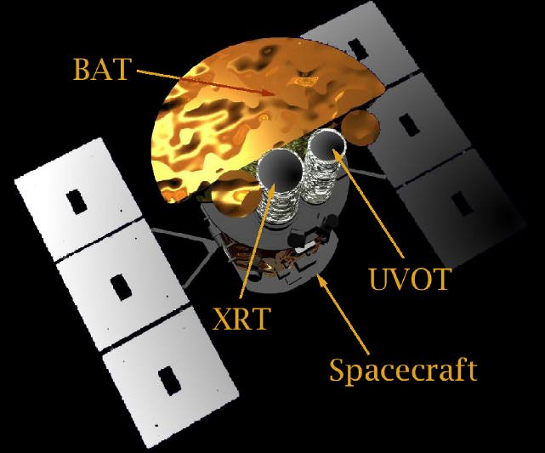

New Missions = Better Data
HETE II (launched 10/9/00)
INTEGRAL (2002)
Swift (2003)
GLAST (2006)

Slide 54

COMING SOON!
Repoints within 50 s after detecting GRB to obtain X-ray and optical data
Detects about 150 GRBs per year and their afterglows
Sends initial coordinates of burst to ground within 15 s
Sends high resolution coordinates of GRB to ground within 50 s
Determines distance to burst within 1000 seconds
Notes:
The Swift Gamma Ray Burst Explorer has a complement of three coaligned instruments: the BATThe Swift Gamma Ray Burst Explorer has a complement of three coaligned instruments: the BAT, XRTThe Swift Gamma Ray Burst Explorer has a complement of three coaligned instruments: the BAT, XRT, and UVOT. The XRT and UVOT are an X-ray and a UV/optical focusing telescope which will produce arcsecond positions and multiwavelength lightcurves for gamma ray Burst (GRB) afterglows. Broad band afterglow spectroscopy will produce redshifts for the majority of GRBs. BAT is a wide Field-Of-View (FOV) coded-aperture gamma ray imager that will produce arcminute GRB positions onboard within 10 seconds. The spacecraft will execute a rapid autonomous slew that will point the focusing telescopes at the BAT position in typically ~ 50s.

Slide 55

GLAST Science
Explore the era of star formation in the universe, the physics of dark matter and the creation and evolution of galaxies

Slide 56

GLAST design

Slide 57

GLAST Technologies

Slide 58

GLAST All Sky Map

Slide 59

Gravity – the final frontier?
Gravity Probe B – will measure frame dragging from Earth orbit – due for launch in 2003
LISA – will look for gravitational radiation emitted from merging black holes, etc.
movie

Slide 60


Gravitational Radiation
The strongest signal comes from two black holes
Black hole mergers in distant galaxies will test General Relativity in the extreme
LISA - First space based Gravitational Wave Telescope

